Slide 1
Ecom Redesign
2016

Slide 2
Business Objectives
Build an ecom that drives the customer quickly through the ecom process.
Incorporate clean design that is intentionally less distracting and more professional.
Drive more conversions by simplifying the ecom process.
Allow us to capture lost leads in an easy manner.

Slide 3
Technical Objectives
Make the design more mobile optimized with UI features that are less obtrusive to mobile visitors.
Capture lead information if no sale occurs
Tighter integration with Marketo
Easier application logic for providing customers with a better/easier experience.

Slide 4
Major Changes
Customer information is captured into Marketo if no screenings are available in the customers area.
Removal of identified risk factors page in the current ecom (it’s a replication of previously given health information provided by the customer.)
Packages are reduced to three or four offerings.
Location page no longer has pagination. It will only show three or four best locations based on the users filtering.
Add ons are moved the payment page.
AWVs will be added during the confirmation page if the customer qualifies.
No Dual Signups

Slide 5
Business Logic Changes
Customers will now be filling out only for themselves or another person. No dual signups. This will reduce errors and speed up the ecom process.
Every customer will have to have a unique email address moving forward.
More questions are gathered upfront (step 1) and customer information is stored within Marketo for future remarketing if we do not service their zip code.
Simple package offerings on one page (visible)
Moving upsells to payment page.
Location page no longer has pagination. It simply shows the best results based on the filters the customer inputs.
AWVs are added to the confirmation page as a lightbox (Only on desktop, function not available on mobile)

Slide 6
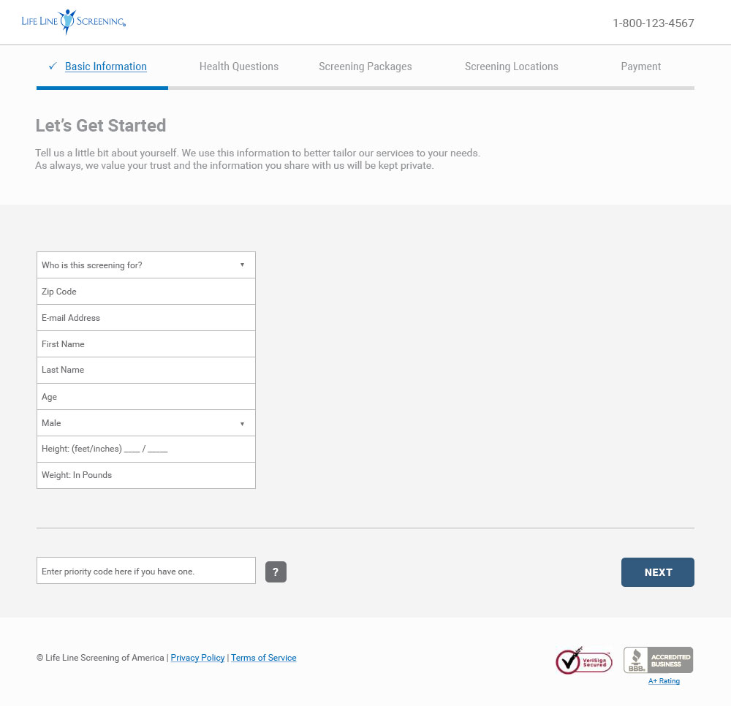

Slide 7
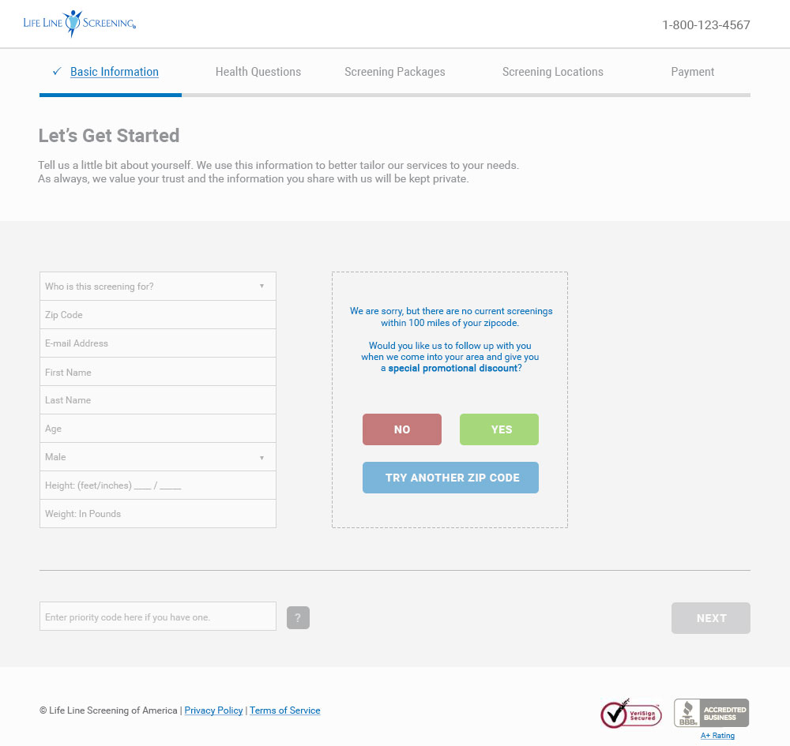

Slide 8
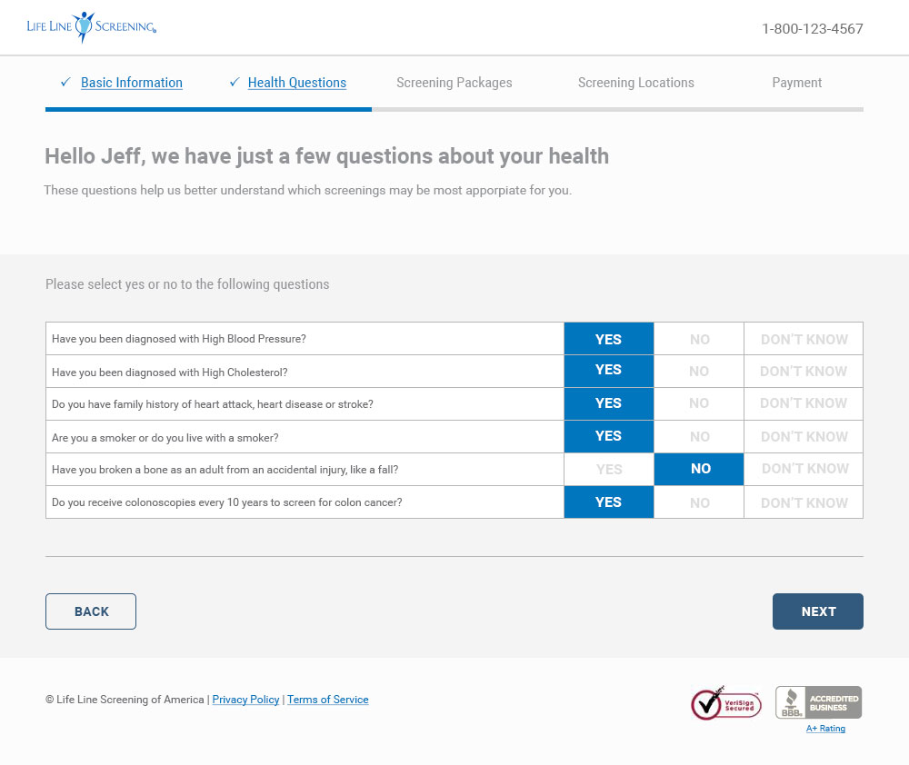

Slide 9
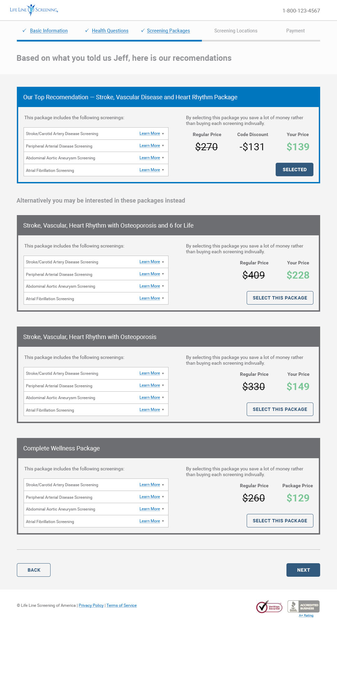

Slide 10
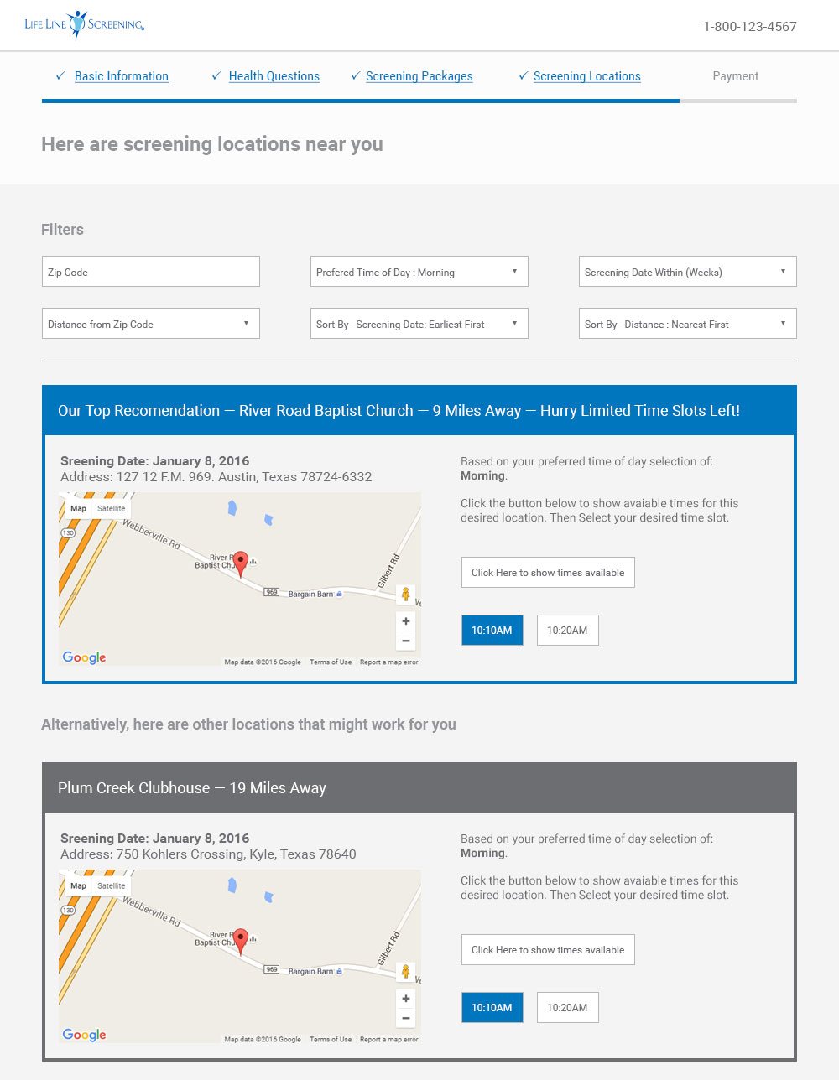


Slide 11
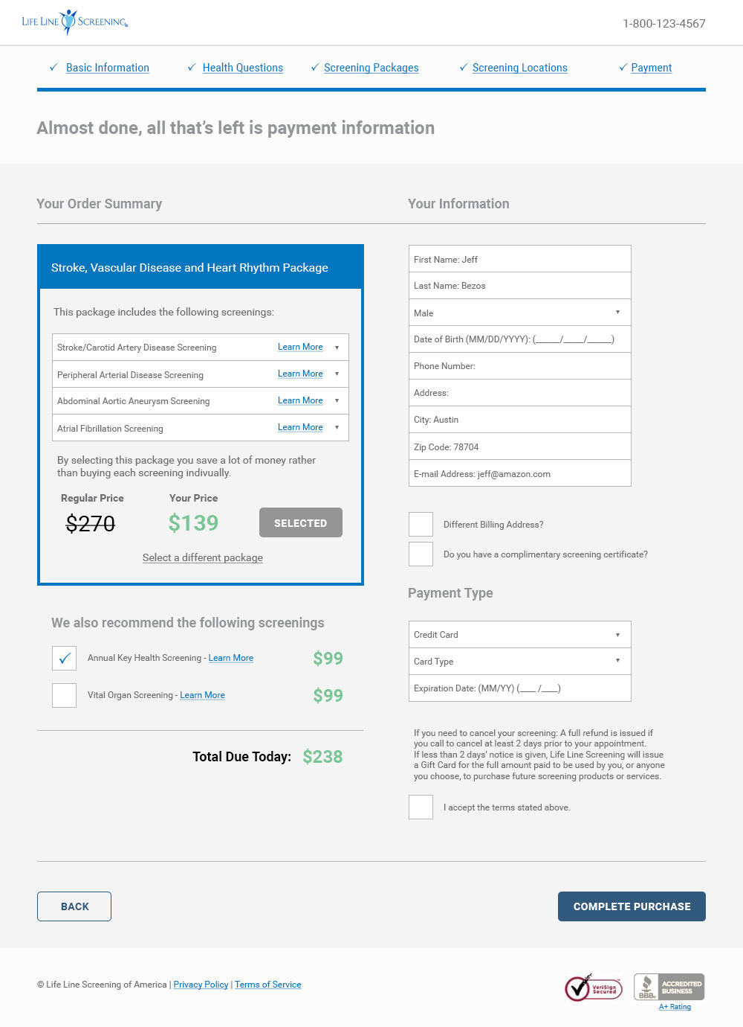

Slide 12
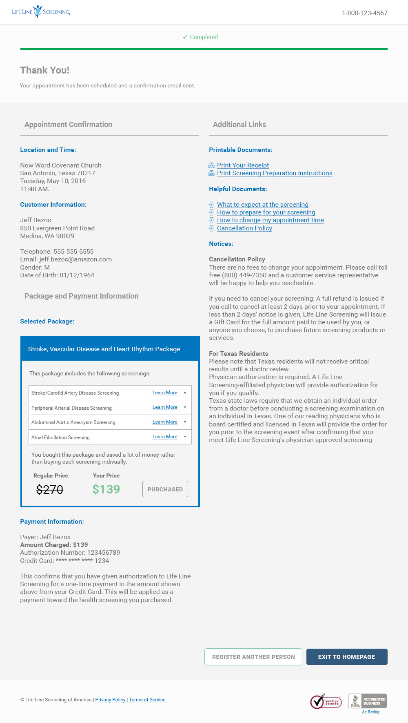

Slide 13
AWV Add-on

Slide 14
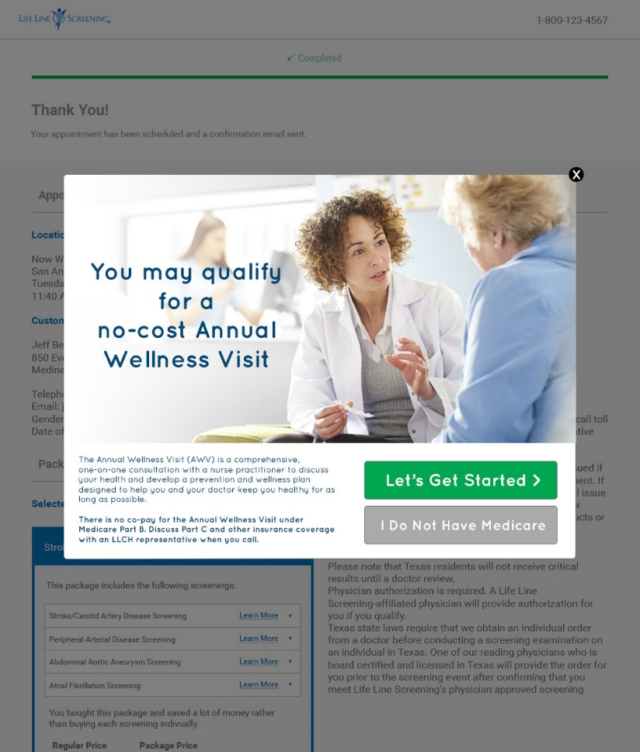

Slide 15
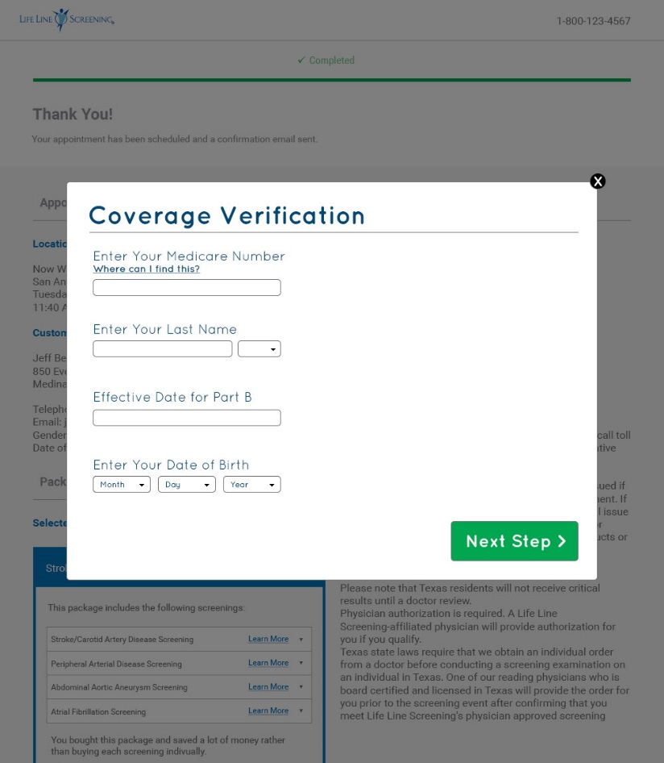

Slide 16
